Slide 1

SOFTWARE ENGINEERING PRINCIPLE
GRAPHICAL USER INTERFACE
EMBEDDED SYSTEM DEVELOPMENT
SANTHOSH NAGENDRAN
8272767

Slide 2
GRAPHICAL USER INTERFACE
Live user interface with the system or a software with some graphics involved to achieve the objective of the system with some user inputs.
GUI is approach of
Designing for people,
Designing for Usage,
Designing by workflow/window/level of complexity.
In this presentation I tried to compare a real software product in the market (a good one and a bad one) to make these concepts of GUI understand better.

Slide 3
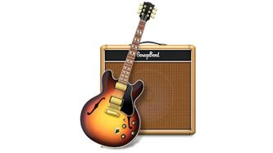

GARAGEBAND
Product of apple runs by macOS.
Product of apple runs by iOS.

Slide 4
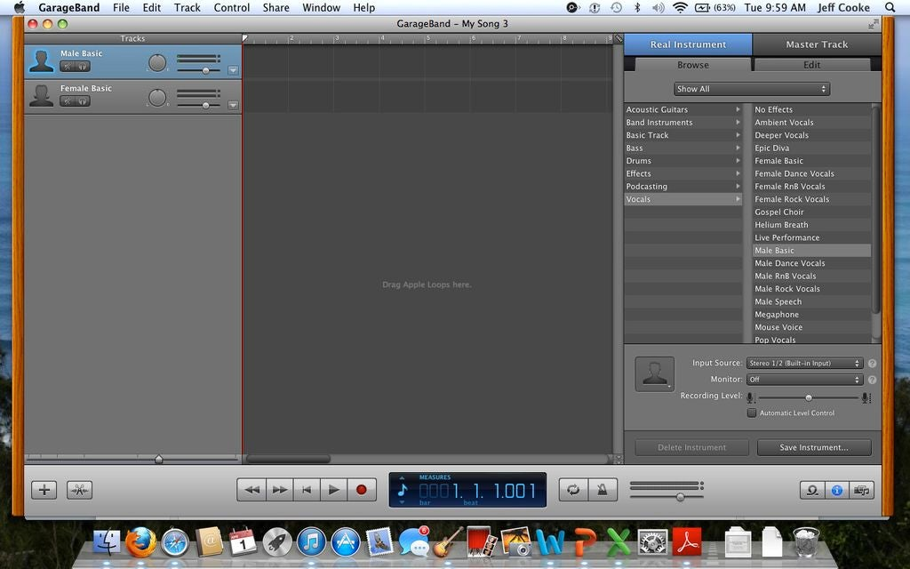
COGNITIVE
Lags in providing context (titles, labels and icons).
Not aware of user’s mental model
Not consistent.(less understanding)
Takes long steps to perform simple actions.

Slide 5
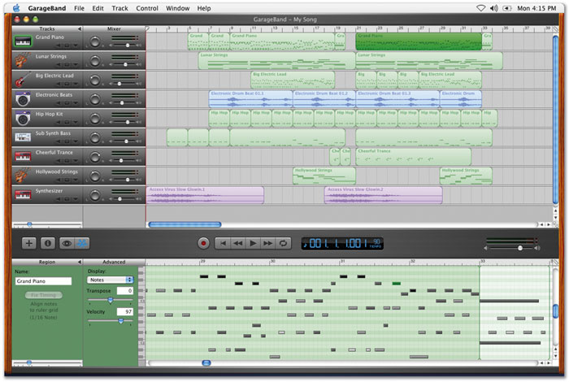
VISUAL CONSIDERATION
This software maximises the eye movement of the users.
Lags in formatting and layouts
Bad color and highlighting

Slide 6
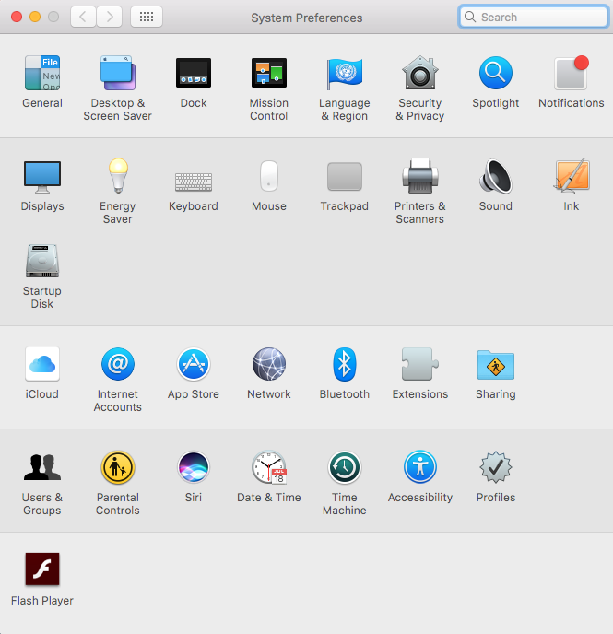
KEY COMBINATIONS
Input device usages
Touch inputs
Typing
Key combination.
The software should allow the users to work freely without the mouse.

Slide 7
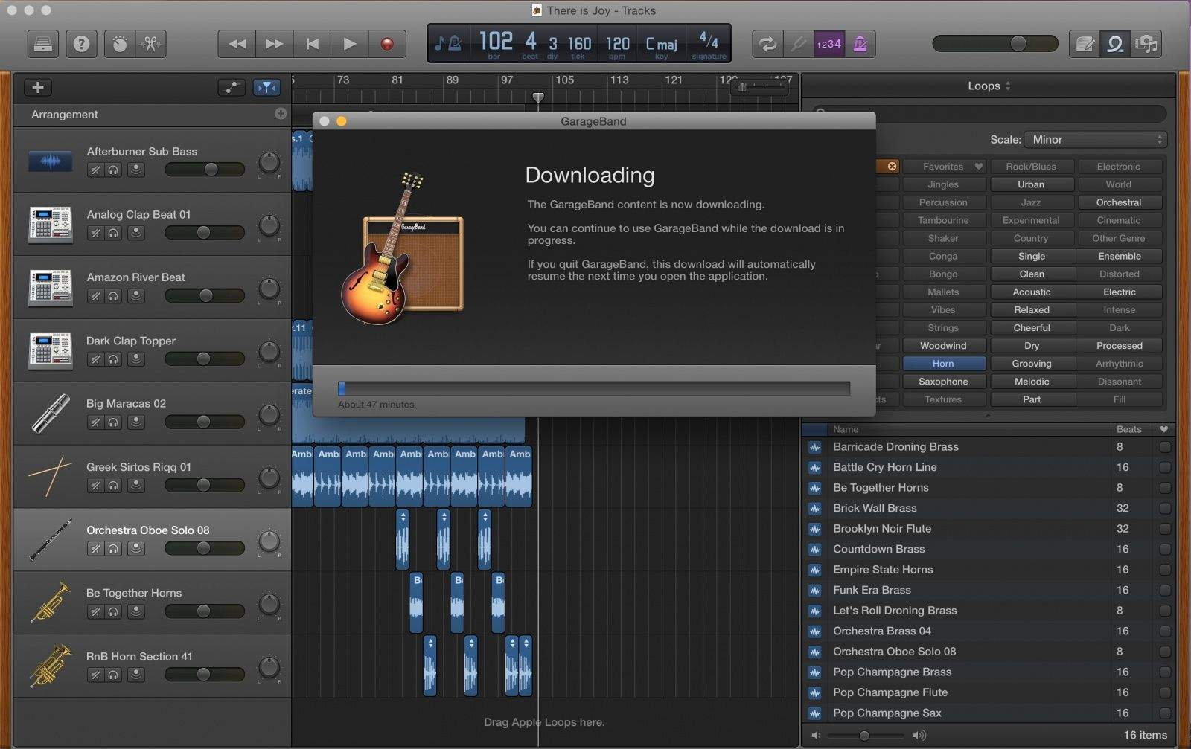
DESIGN BY USAGE
The purpose of the software is to entertain and compose a song or tune.
It should allow the users to store their work and freely accessible.
This software has the option only to upload to the cloud.

Slide 8
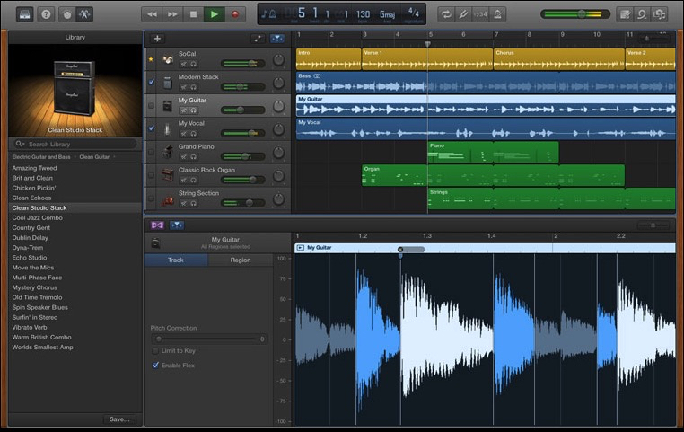
DESIGN BY WORK FLOW
User’s doesn’t know where they are most of the time.
It becomes slower when the user clicks any icon in the software.
It should take only small number of steps to get anywhere in the application.

Slide 9
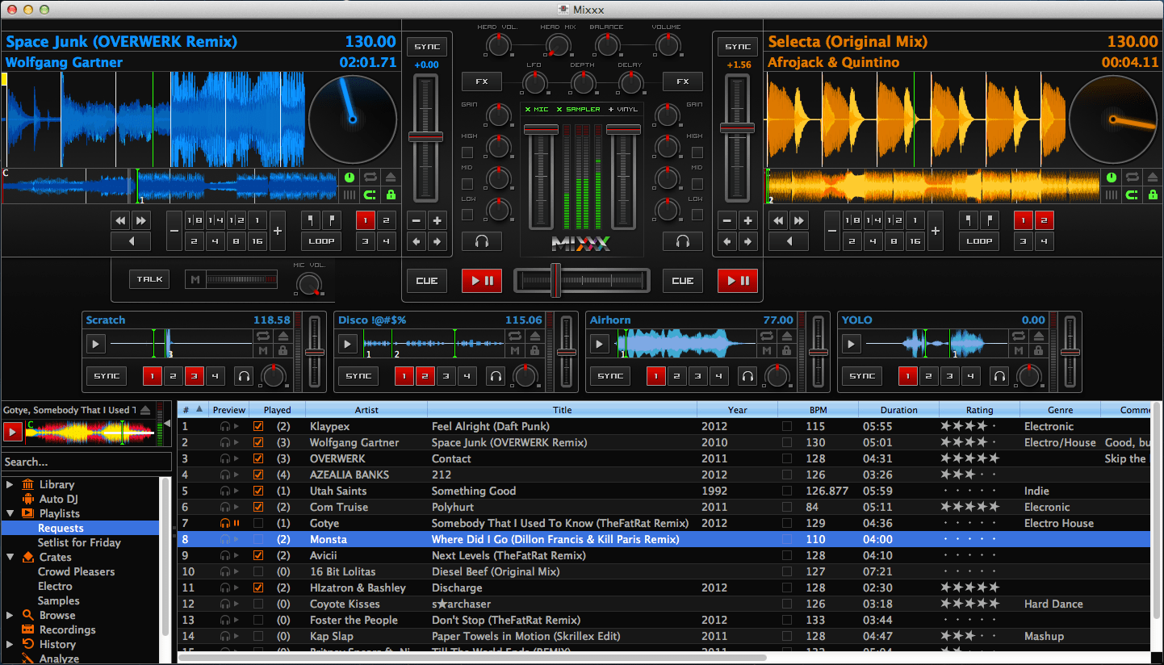
DESIGN GUIDELINES OF WINDOW
It should be easily understood at the 1st glance
Use standard layouts.
Clearly label and icon everything
Don’t put too much on a window.

Slide 10
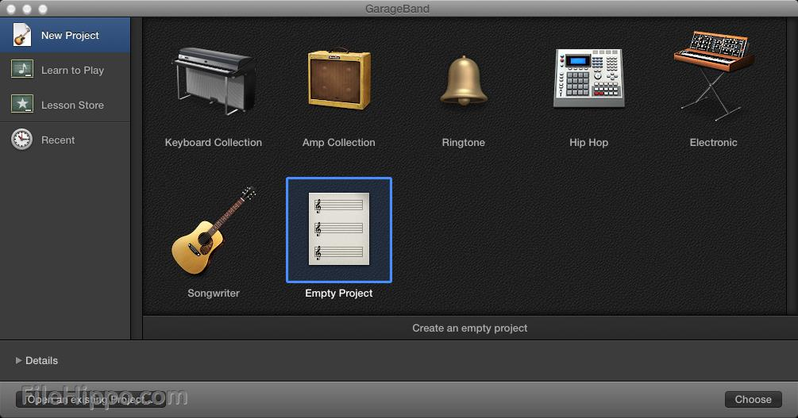
COMPLEXITY GUIDELINES
Make hard stuffs easy
Give some alternative paths.
Be consistent in the user interface
Garage band had followed the consistency but on the other side.
This garage band is less interactive and more complex with less interactions.
This software has been concentrated mainly on the high level advanced users of musical software with good computer knowledge.

Slide 11
In contrast we have the same in iOS

Slide 12
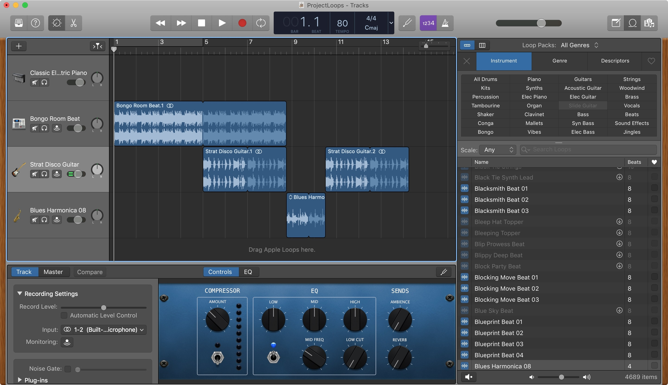
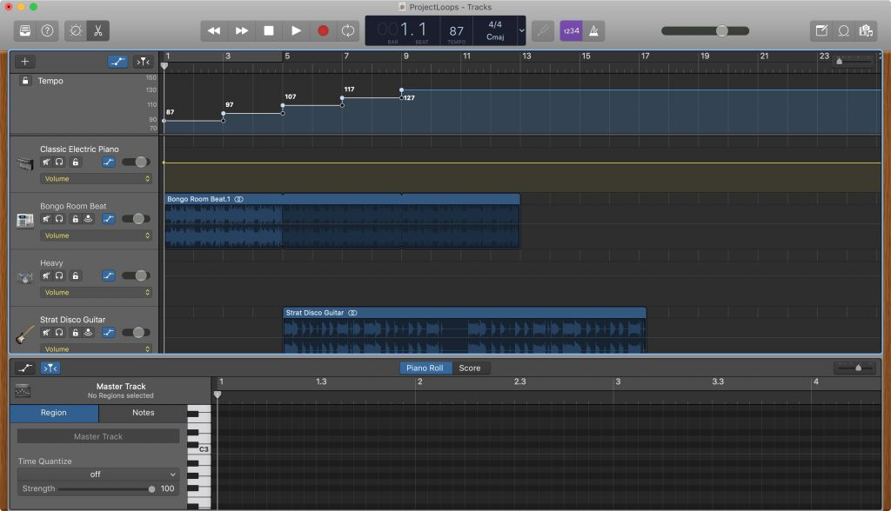
COGNITIVE
provides context (titles, labels and icons).
Good awareness of user’s mental model
More consistent & understanding
Takes less steps to perform any actions.

Slide 13
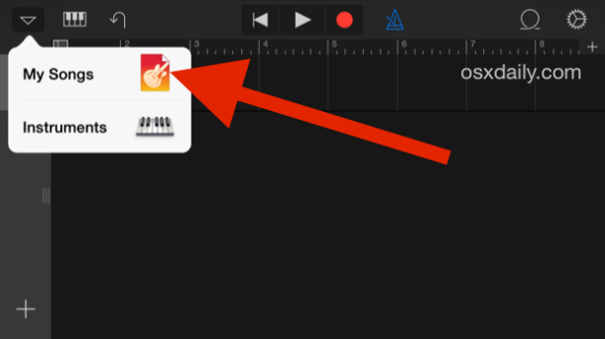
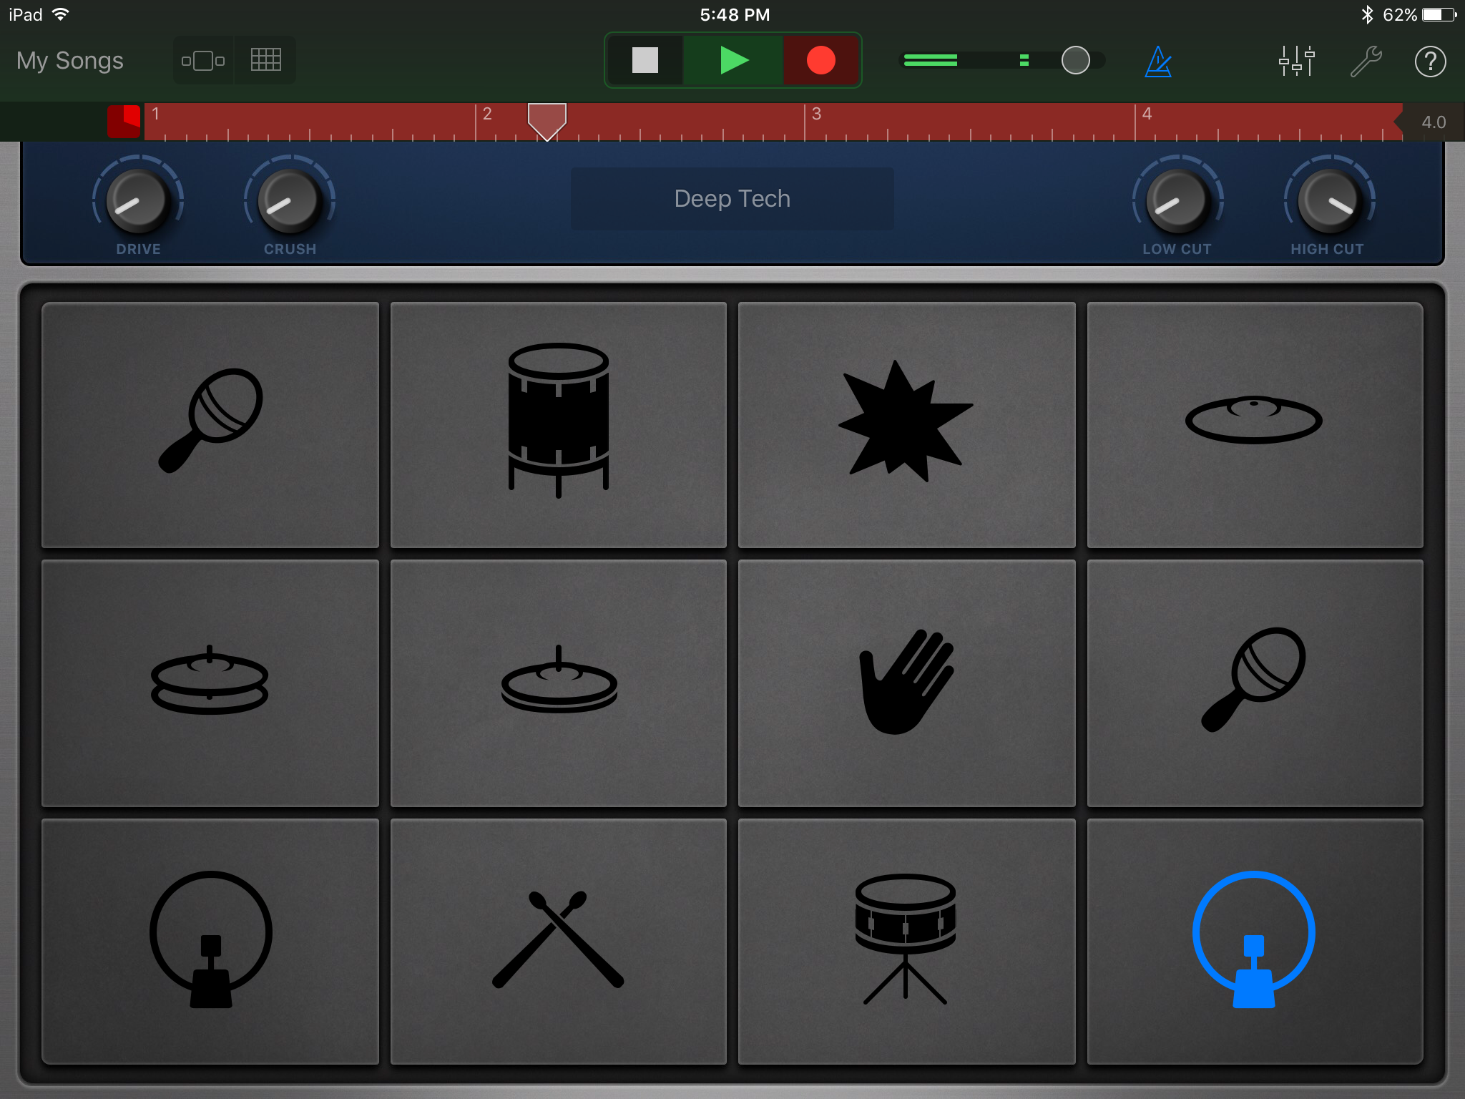
VISUAL CONSIDERATION
This software minimises the eye movement of the users.
Good formatting and layouts
Aesthetic colors and highlighting

Slide 14
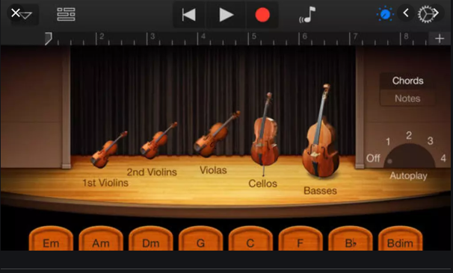
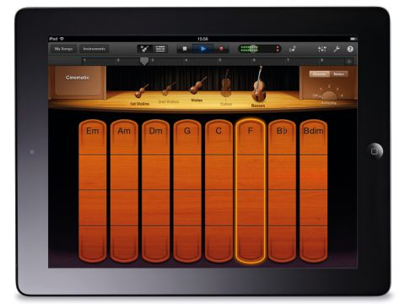
KEY COMBINATIONS
Input device usages
Touch inputs
Typing
Key combination.
The software allows the users to work freely with & without the mouse.

Slide 15
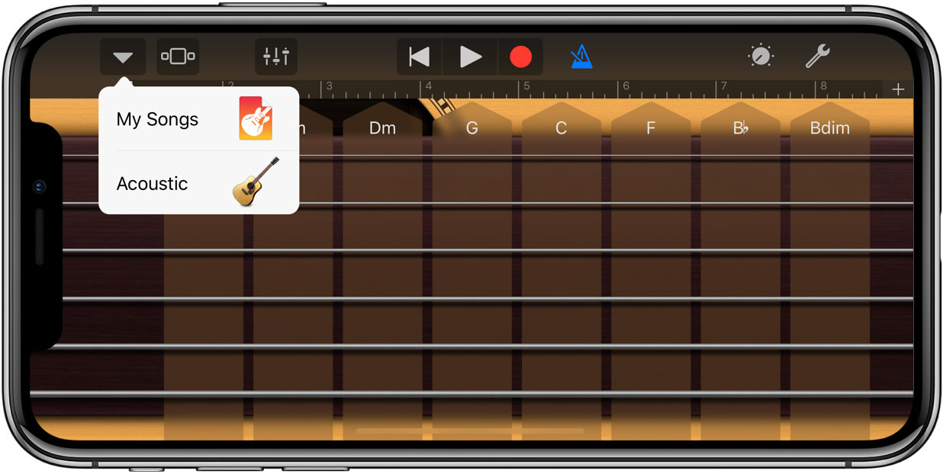
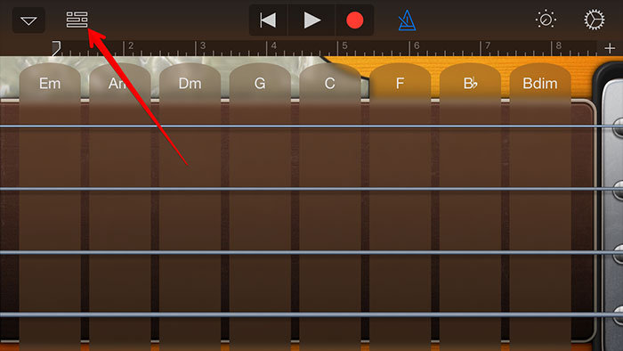
DESIGN BY USAGE
The purpose of the software is to entertain and compose a song or tune.
It allows the users to store their work and free to access.
This software has the option only to upload to the cloud.

Slide 16
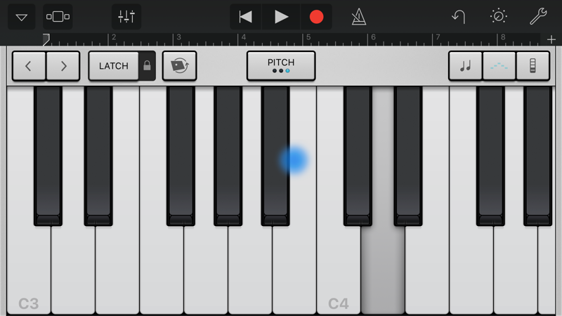
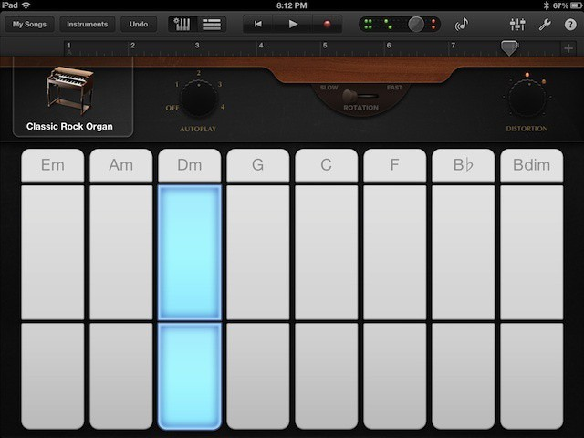

Slide 17
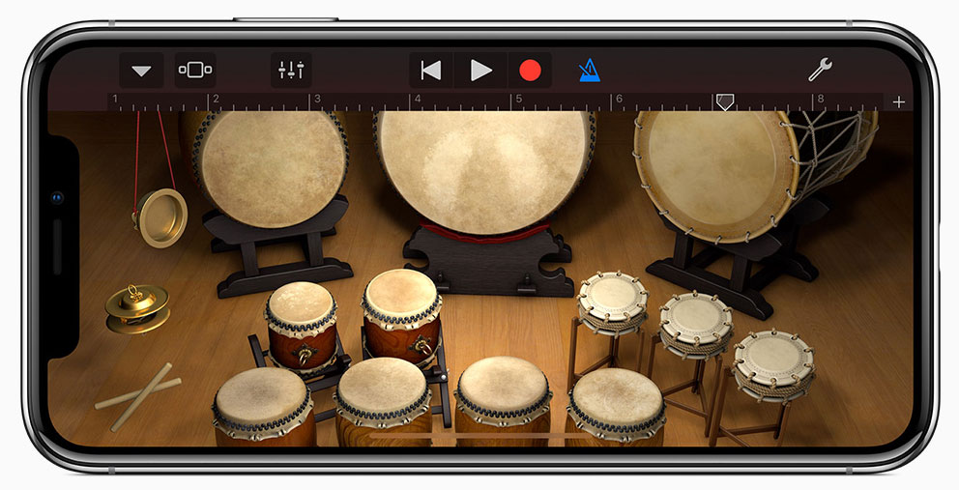
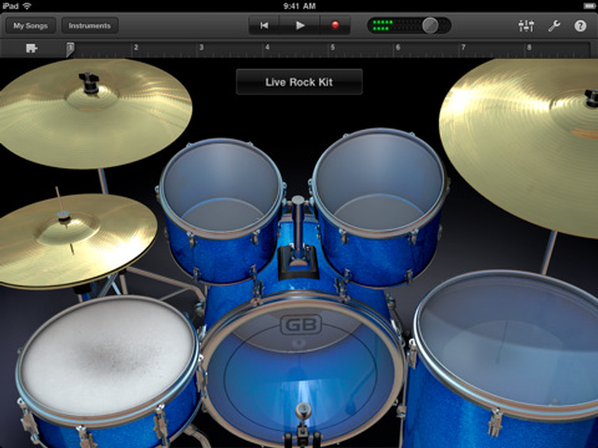
DESIGN BY WORK FLOW
User’s knows where they are all the time.
It reacts fast when the user clicks any icon in the software.
It takes only small number of steps to get anywhere in the application.

Slide 18
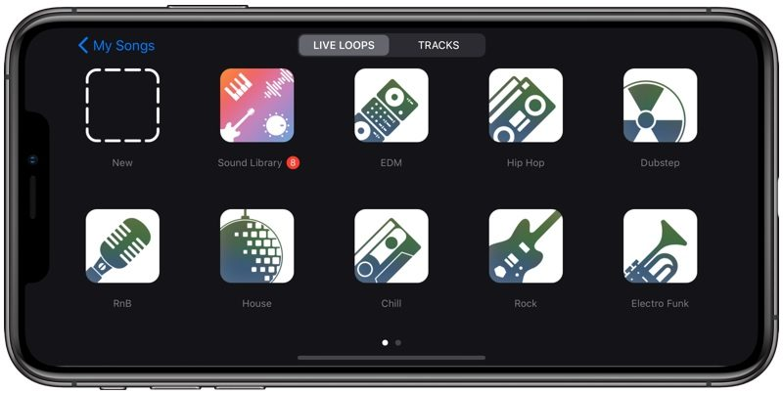
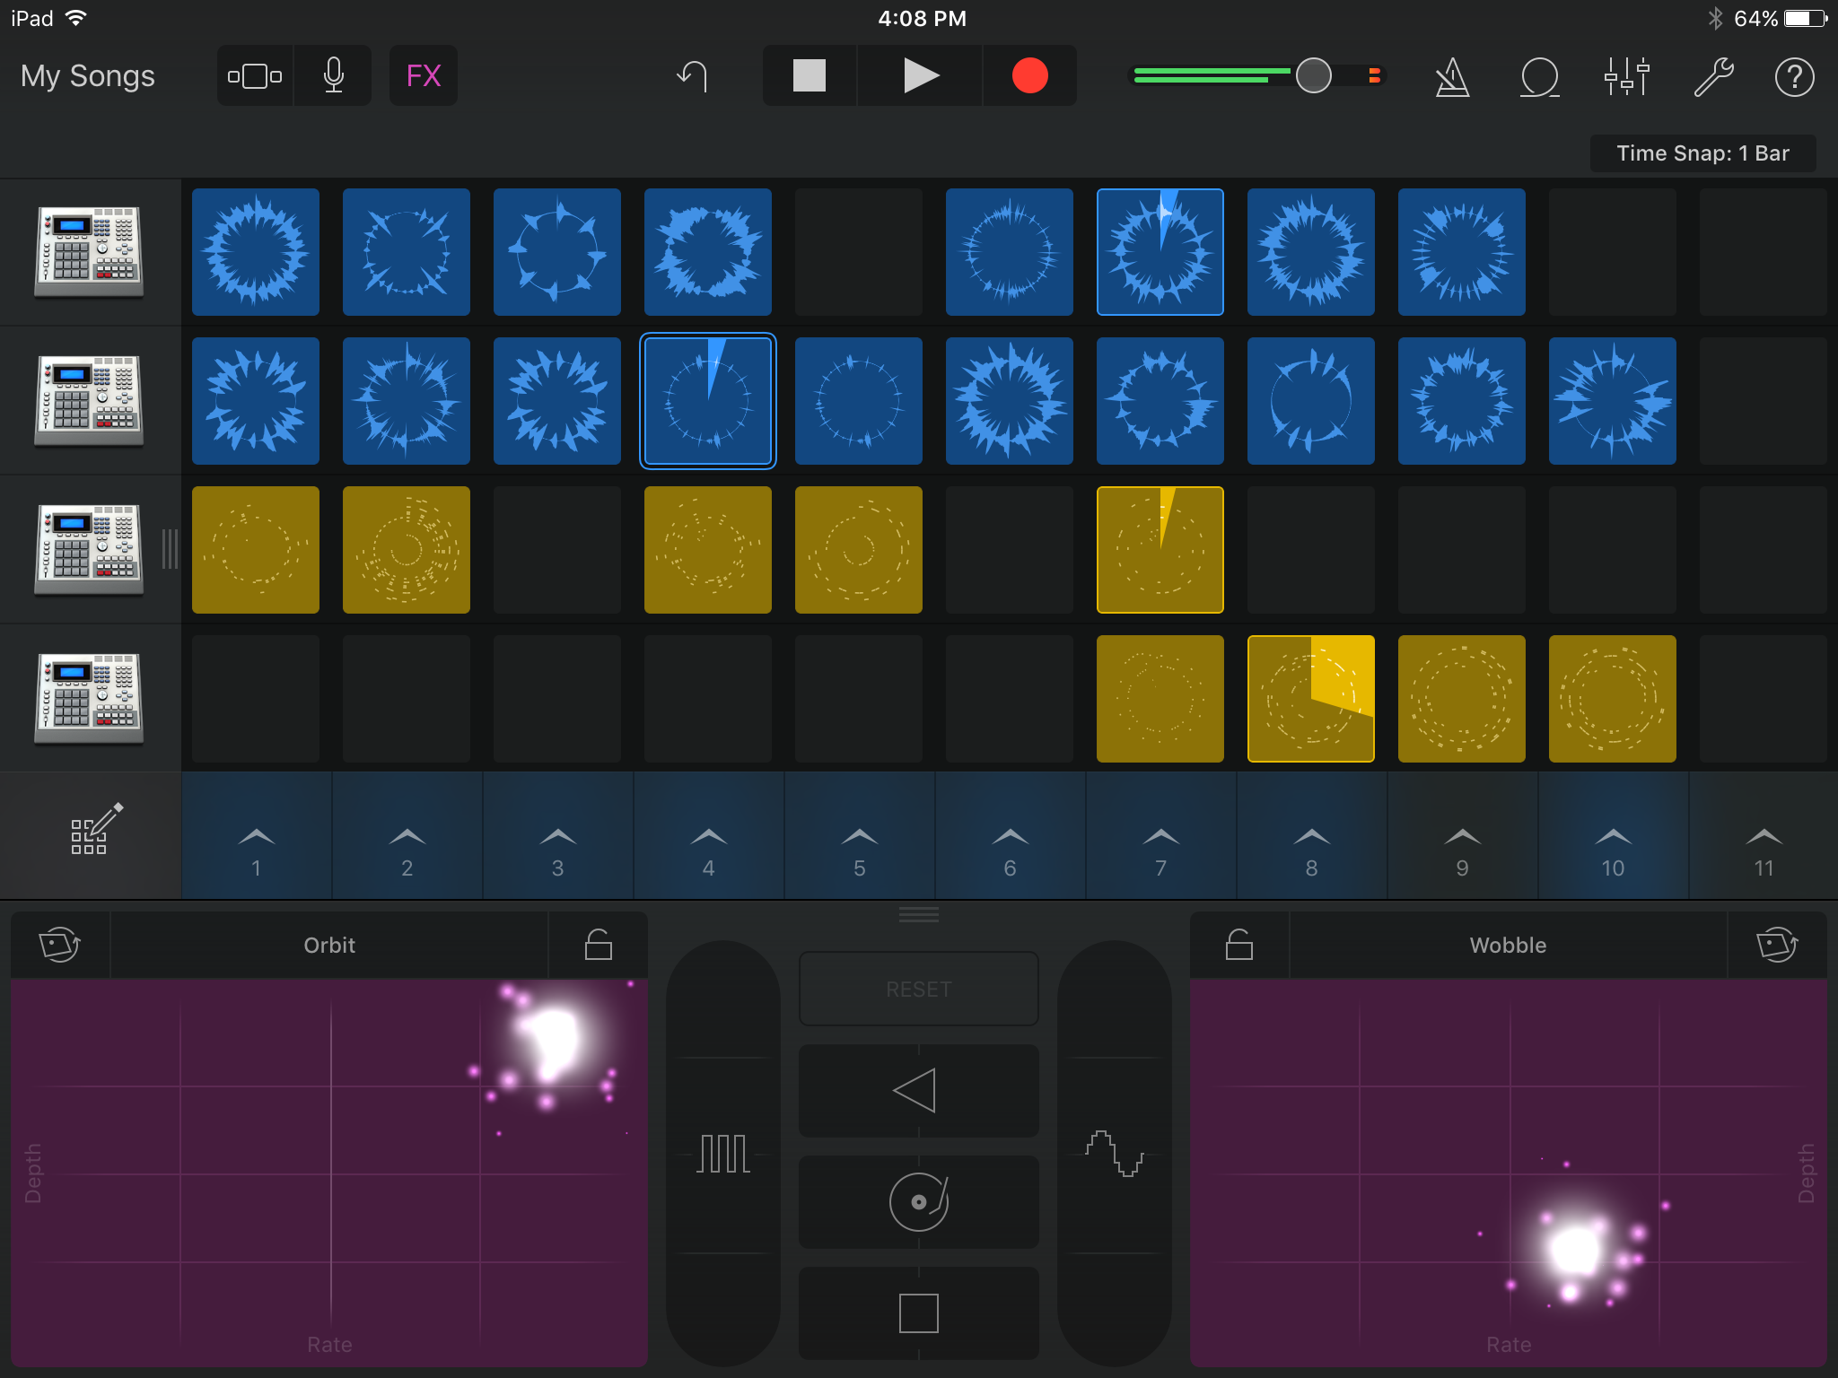
DESIGN GUIDELINES OF WINDOW
It is easy to understand at the 1st glance
Uses standard layouts.
Clear labels and icons everywhere
Includes only necessary information

Slide 19
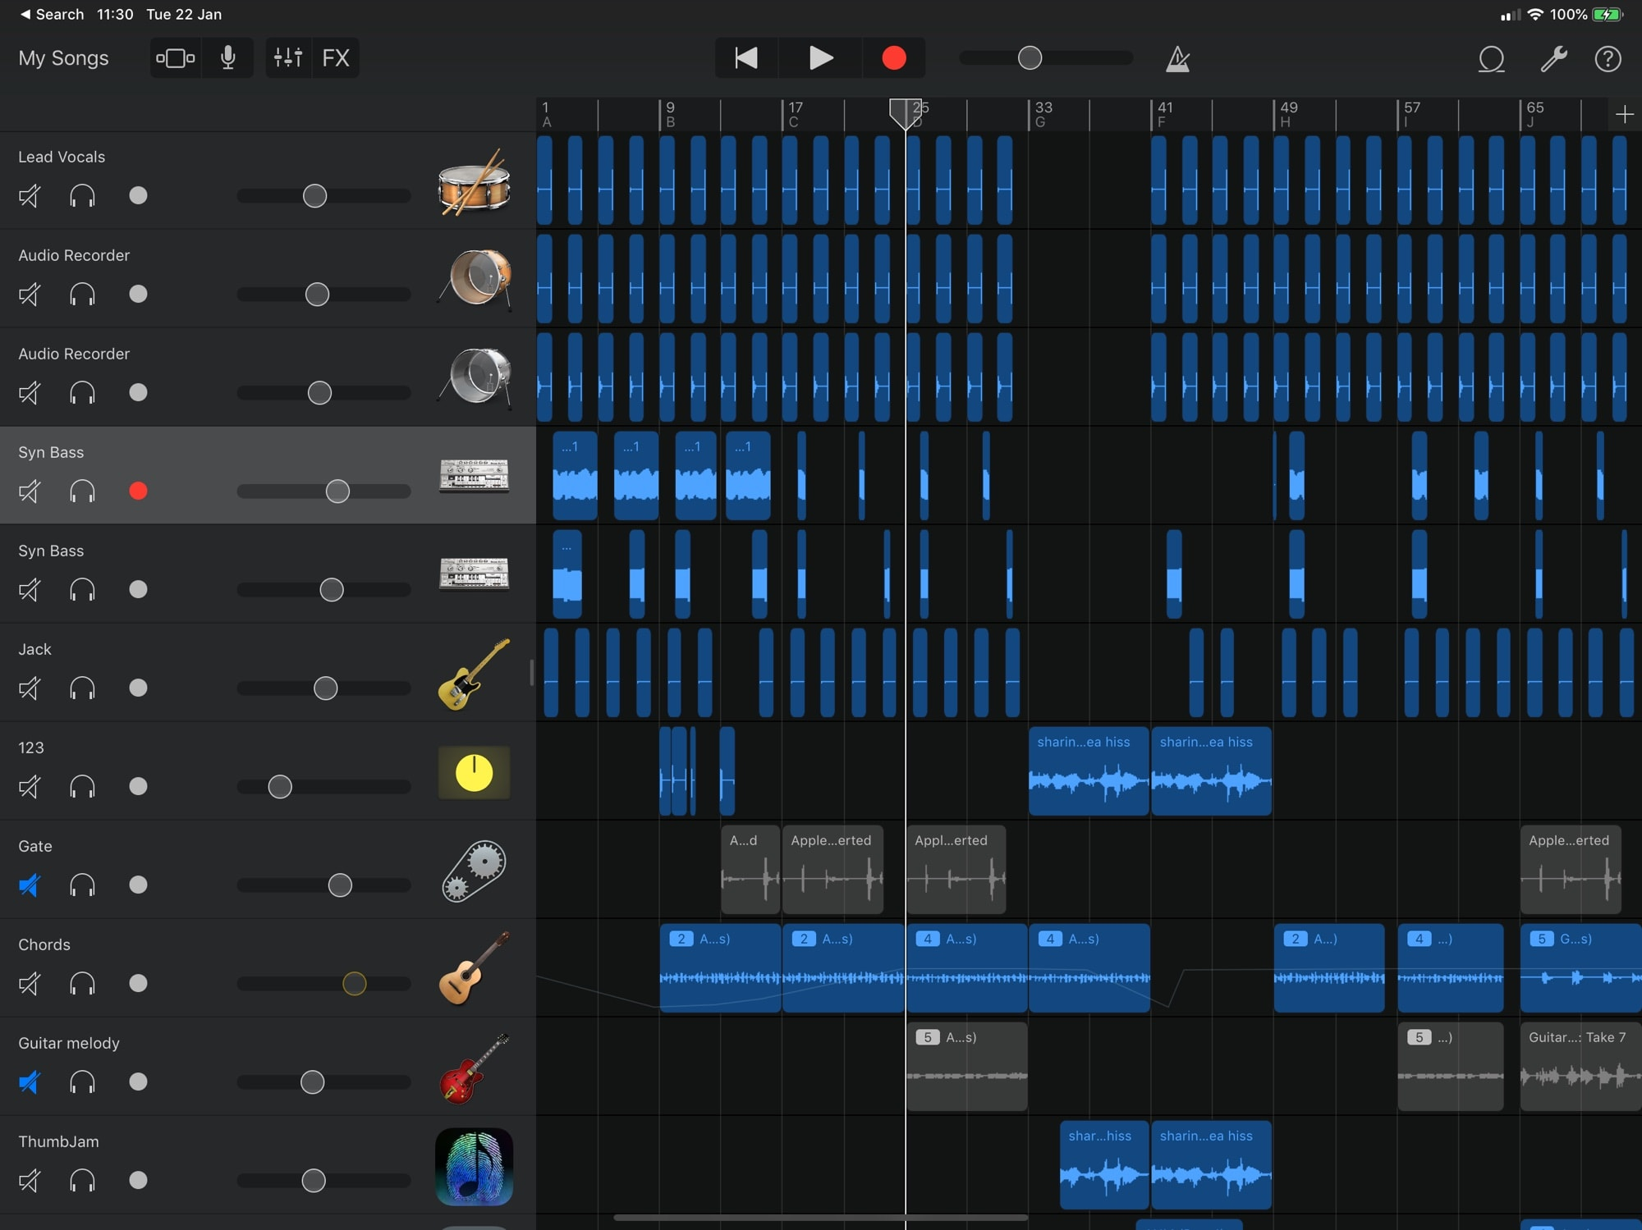
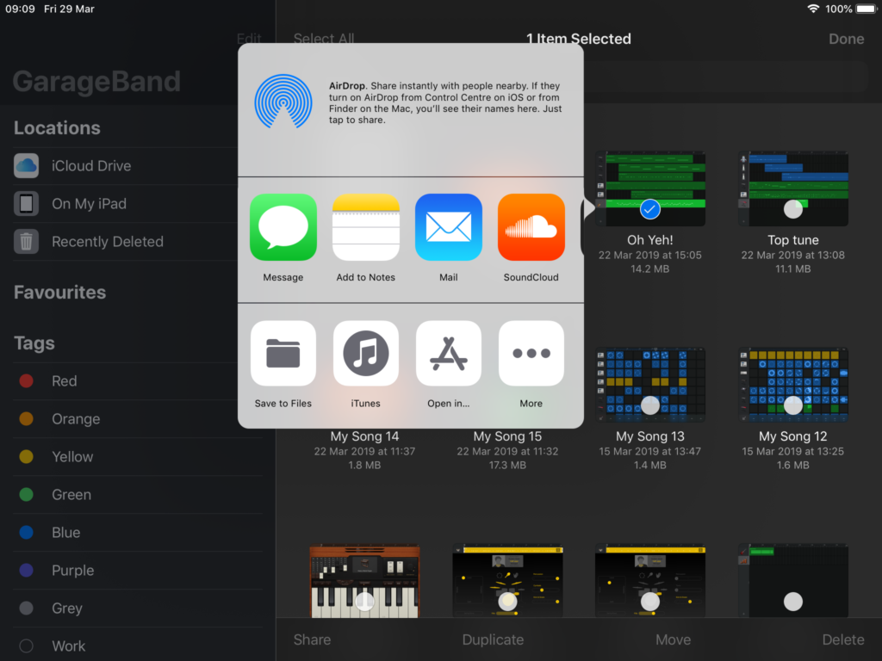
COMPLEXITY GUIDELINES
Make hard stuffs easy
Gives alternative paths.
Being consistent in the user interface
This garage band is more interactive and less complex.
This software has been concentrated mainly for the beginners of musical software with minimal knowledge.

